Slide 1


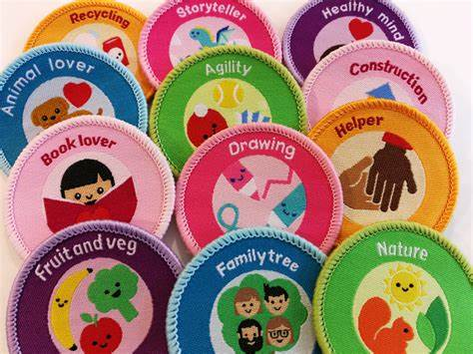
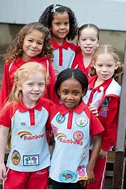


2ND Llandaff north rainbow unit
We have spaces in the 2nd Llandaff north rainbow unit
The unit is in the Llandaff north community centre
Next to hawthorn primary school
If you're interested in joining the rainbow unit, please contact Tracy young, via email-2ndlandaffnorthrainbows@gmail.com or phone number- 07484192852.
The rainbow would receive lots of certificates and badge which they work toward each meeting.
The rainbows play lots of fun games and do lots of crafts in the meeting
The 2nd Llandaff north rainbow unit time is 4-5 pm, Friday’s
The meeting are school term times.

