Slide 1
RSE Progression
Discovery Education Progression Grids

Slide 2
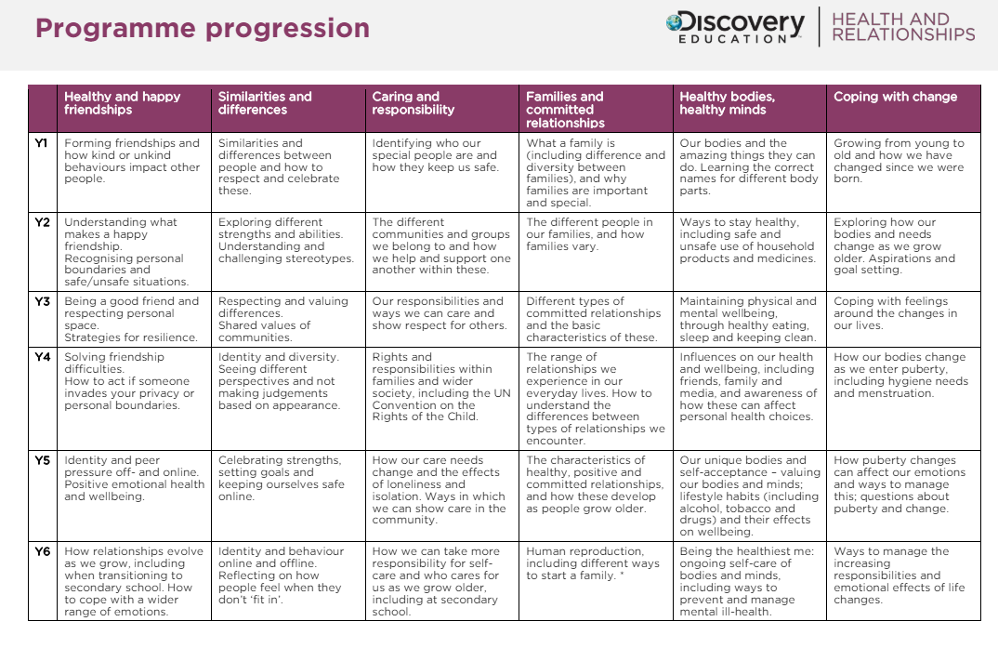

Slide 3


Slide 4
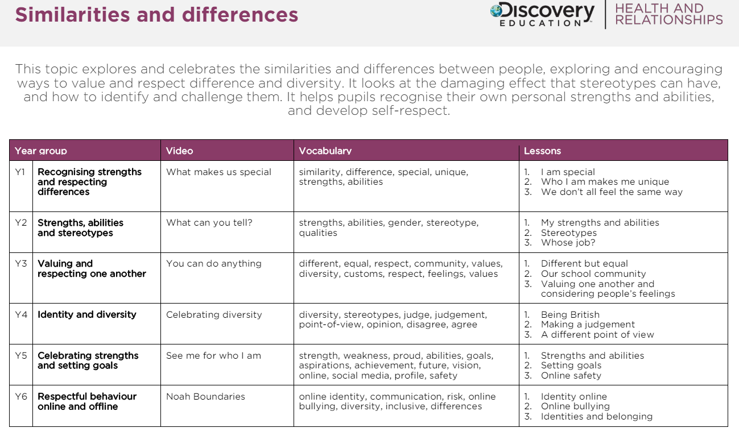

Slide 5


Slide 6
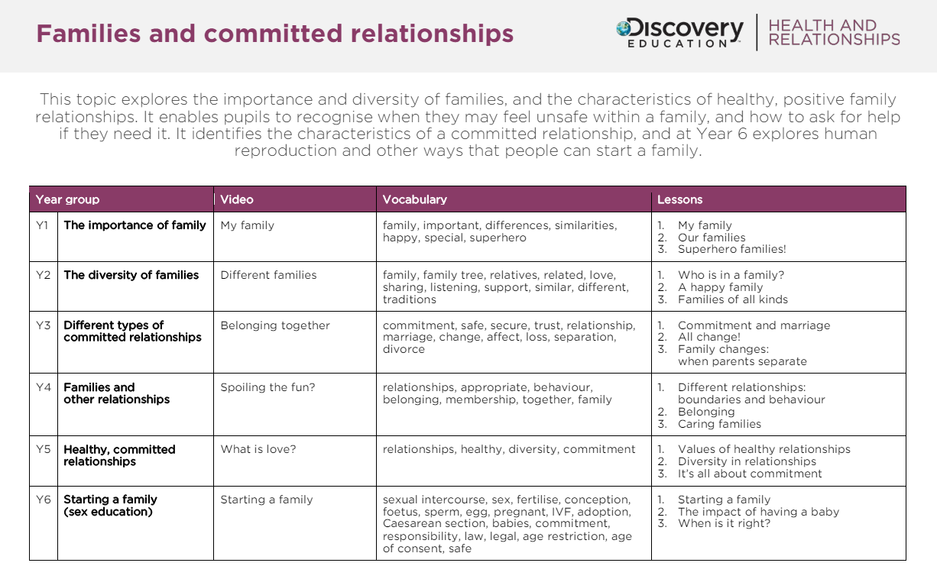

Slide 7
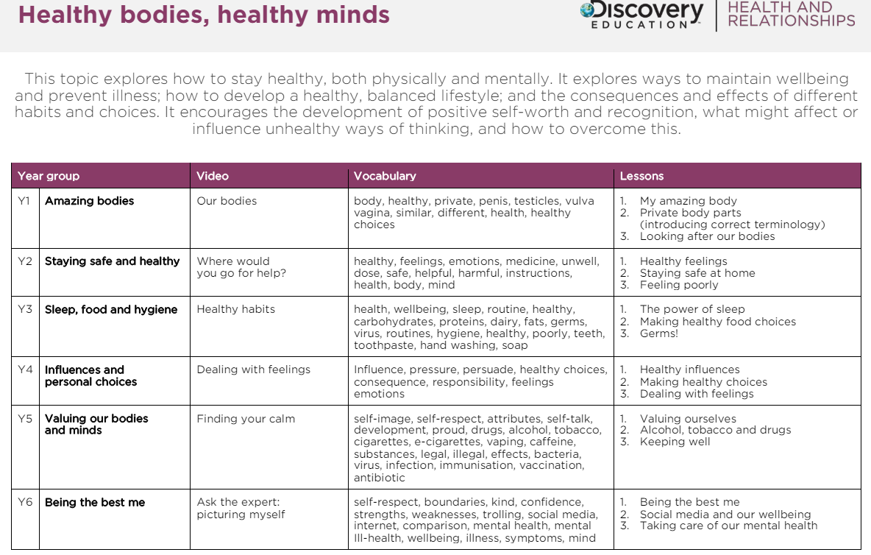

Slide 8


